Slide 1
One Ocean Havbyen Bergen
One Ocean is a collaboration between actors from business, academia, and the public sector, focusing on sustainable value creation, knowledge, and research related to the ocean.
One Ocean is founded by The City of Bergen, The Vestland County and The University of Bergen, with an active contribution from the Institute of Marine Researche and The Bergen Chamber of Commerce and Industry.
One Ocean consists of nearly 100 collaboration partners.

Slide 2
One Ocean Week
One Ocean Week is an annual event for debate, exchange of experiences, and activities related to the sustainable use of the ocean.
One Ocean Week brings together stakeholders from research, education, business, public administration, and civil society
One Ocean Week facilitates networking and professional development, and puts current topics such as marine industry, politics, climate, resource management, and blue economy on the agenda.
One Ocean Week is part of the UN Decade of Ocean Science for Sustainable Development.
Visit: www.OneOceanWeek.com

Slide 3
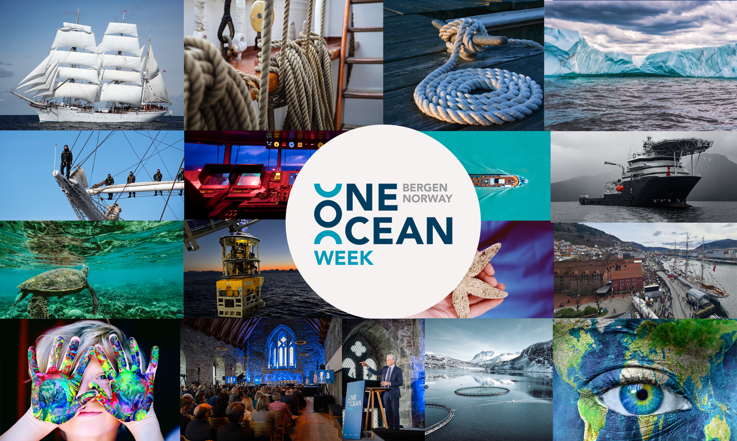

Slide 4




