Slide 1
One Ocean
Nearly 100 partners from business and industry, academia and the public sector.

Slide 2
One Ocean Week
One Ocean Week is an annual event for debate, exchange of experiences, and activities related to the sustainable use of the ocean.
One Ocean Week is part of the UN Decade of Ocean Science for Sustainable Development.
Visit: www.OneOceanWeek.com

Slide 3
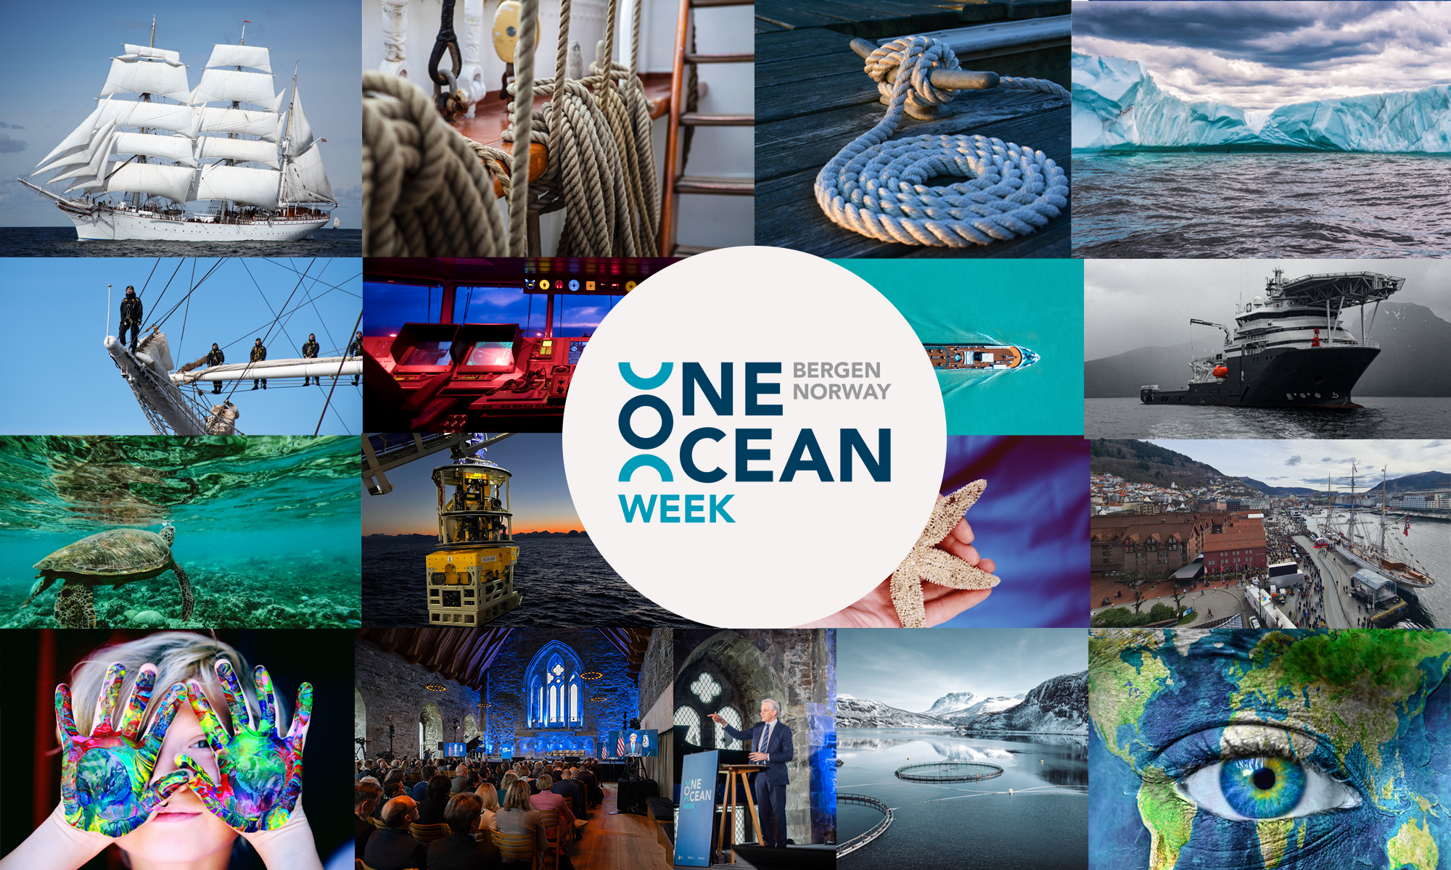

Slide 4




